Slide 1
Length Contraction

Slide 2
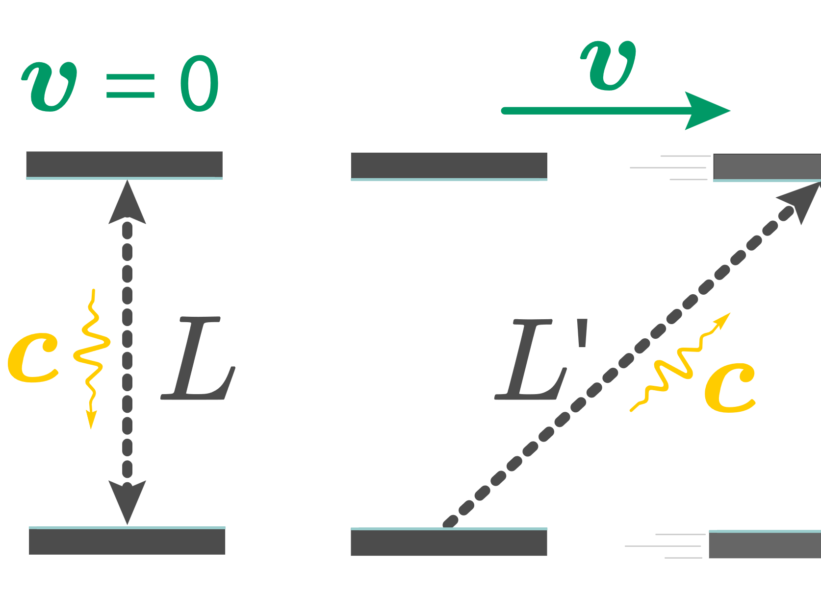
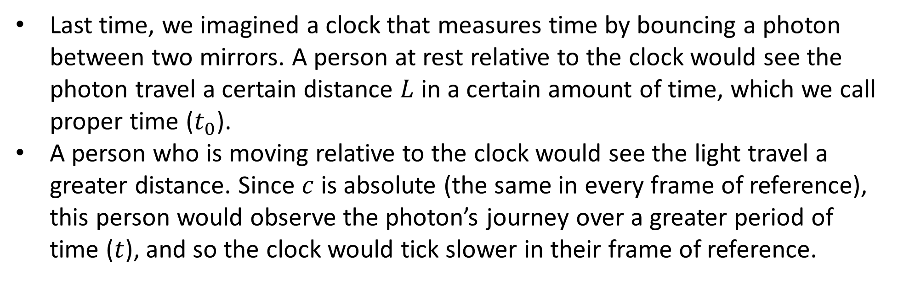
Time Dilation Review
Last time, we imagined a clock that measures time by bouncing a photon between two mirrors. A person at rest relative to the clock would see the photon travel a certain distance $L$ in a certain amount of time, which we call proper time ($t_{0}$).
A person who is moving relative to the clock would see the light travel a greater distance. Since $c$ is absolute (the same in every frame of reference), this person would observe the photon’s journey over a greater period of time ($t$), and so the clock would tick slower in their frame of reference.

Slide 3
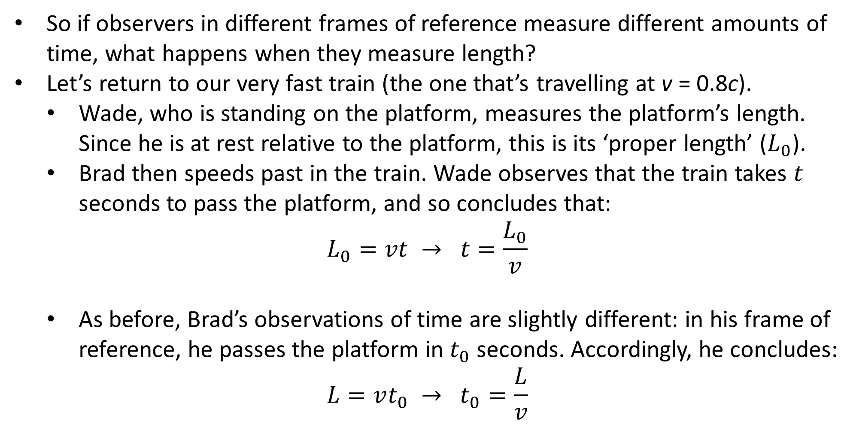
Observing Length
So if observers in different frames of reference measure different amounts of time, what happens when they measure length?
Let’s return to our very fast train (the one that’s travelling at v = 0.8c).
Wade, who is standing on the platform, measures the platform’s length. Since he is at rest relative to the platform, this is its ‘proper length’ ($L_{0}$).
Brad then speeds past in the train. Wade observes that the train takes $t$ seconds to pass the platform, and so concludes that:
$$L_{0}=vt → t=\frac{L_{0}}{v}$$
As before, Brad’s observations of time are slightly different: in his frame of reference, he passes the platform in $t_{0}$ seconds. Accordingly, he concludes:
$$L=vt_{0} → t_{0}=\frac{L}{v}$$

Slide 4
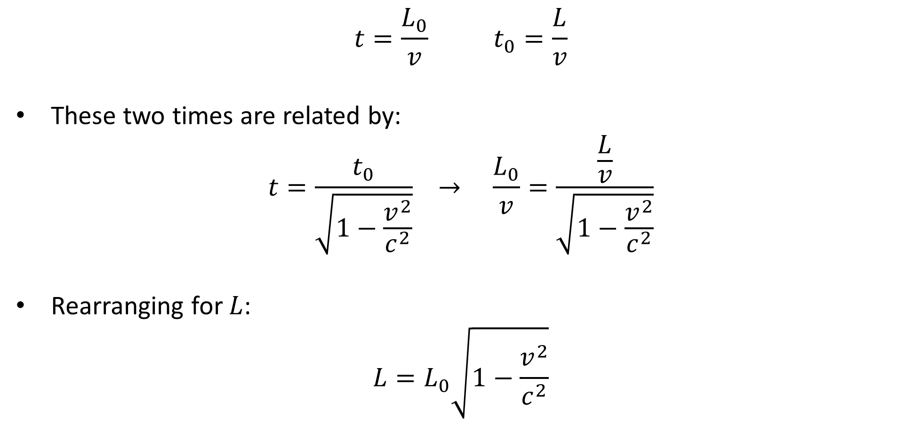
Length Contraction
$$t=\frac{L_{0}}{v} t_{0}=\frac{L}{v}$$
These two times are related by:
$$t=\frac{t_{0}}{\sqrt{1−\frac{v^{2}}{c^{2}}}} → \frac{L_{0}}{v}=\frac{\frac{L}{v}}{\sqrt{1−\frac{v^{2}}{c^{2}}}}$$
Rearranging for $L$:
$$L=L_{0}\sqrt{1−\frac{v^{2}}{c^{2}}}$$
Notes:
In your formula sheet ℓ and ℓ₀ are used.

Slide 5
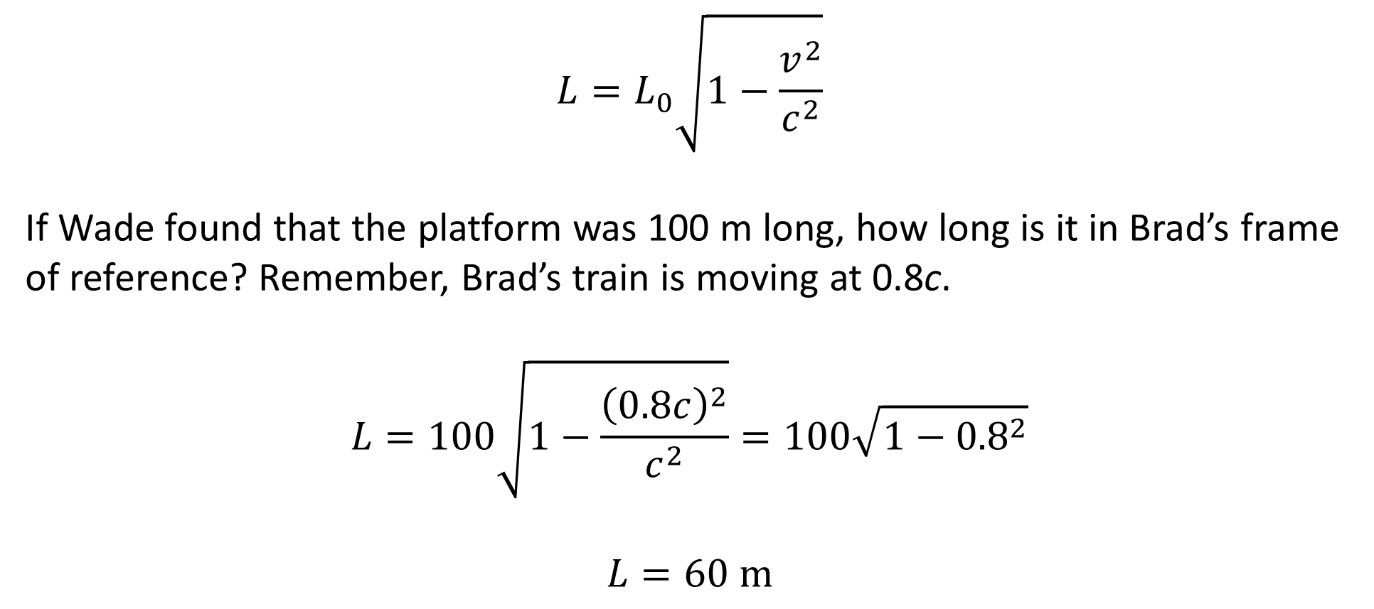
Example #1
$$L=L_{0}\sqrt{1−\frac{v^{2}}{c^{2}}}$$
If Wade found that the platform was 100 m long, how long is it in Brad’s frame of reference? Remember, Brad’s train is moving at 0.8c.
$$L=100\sqrt{1−\frac{{\left(0.8c\right)}^{2}}{c^{2}}}=100\sqrt{1−{0.8}^{2}}$$
$$L=60 \text{m}$$

Slide 6
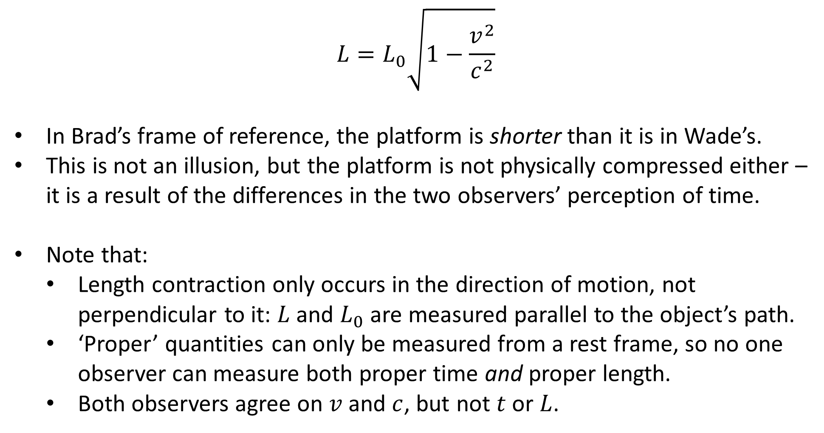
Length Contraction
$$L=L_{0}\sqrt{1−\frac{v^{2}}{c^{2}}}$$
In Brad’s frame of reference, the platform is shorter than it is in Wade’s.
This is not an illusion, but the platform is not physically compressed either – it is a result of the differences in the two observers’ perception of time.
Note that:
Length contraction only occurs in the direction of motion, not perpendicular to it: $L$ and $L_{0}$ are measured parallel to the object’s path.
‘Proper’ quantities can only be measured from a rest frame, so no one observer can measure both proper time and proper length.
Both observers agree on $v$ and $c$, but not $t$ or $L$.

Slide 7
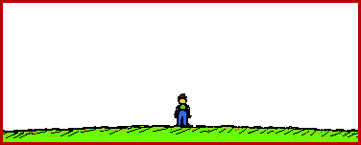
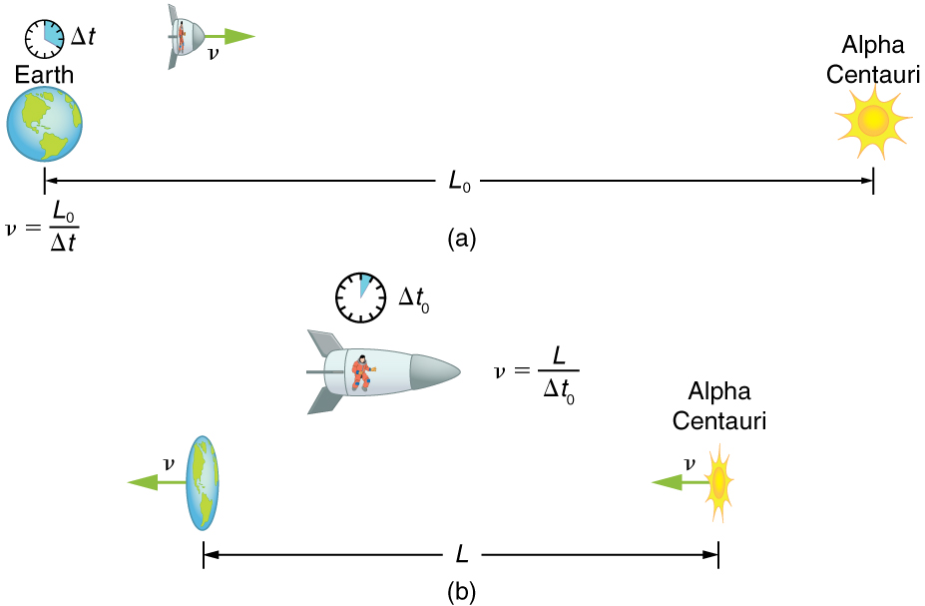
Length Contraction
Length contraction applies to objects:
But also to distances:
0.1c
0.865c
0.99c
So when you watch things moving quick
Their length is short, their clocks don’t tick
(Turns out it also makes them fat…
…but maybe we’ll come back to that)

Slide 8

Notes:
This clip is about as much of this video as you need to understand. There’s a simpler and more complete explanation at https://youtu.be/FPzGAksFCbs

Slide 9
Example #2
A spaceship travels to a star 35 lightyears away at a speed of 2.70 × 10⁸ m s⁻¹. How long does the spaceship take to get to the star
as measured on Earth?
as measured by a passenger on the spaceship?
How far away is the star, as measured by a passenger on the spaceship?
Notes:
L₀ = 3.31128 × 10¹⁷ m
t = L₀ / v = 1.2264 × 10⁹ s
t₀ = 5.3458 × 10⁸ s
L = 1.4434 × 10¹⁷ m
Sanity checks: t₀ < t, L < L₀

Slide 10
Example #3
Abbey believes that length contraction is absurd, and proposes the following thought experiment to prove it:
“Bob flies a spaceship with a proper length of 100 m through a tunnel with a proper length of 60 m. By flying extra fast, he can contract the length of the spaceship to 50 m, allowing it to fit into the tunnel completely. At the moment that the spaceship is fully inside the tunnel, Caity (who is standing in the tunnel) presses a button that simultaneously closes two doors at either end of the tunnel. The doors then immediately open again to let the spaceship out.
But from Bob’s perspective, the tunnel is moving, so it is affected by length contraction. He’s flying a 100 m spaceship through a 30 m tunnel, so there’s no way both doors could close at the same time without hitting the ship!”
Using your understanding of special relativity, explain how this situation is resolved.

